Slide 1
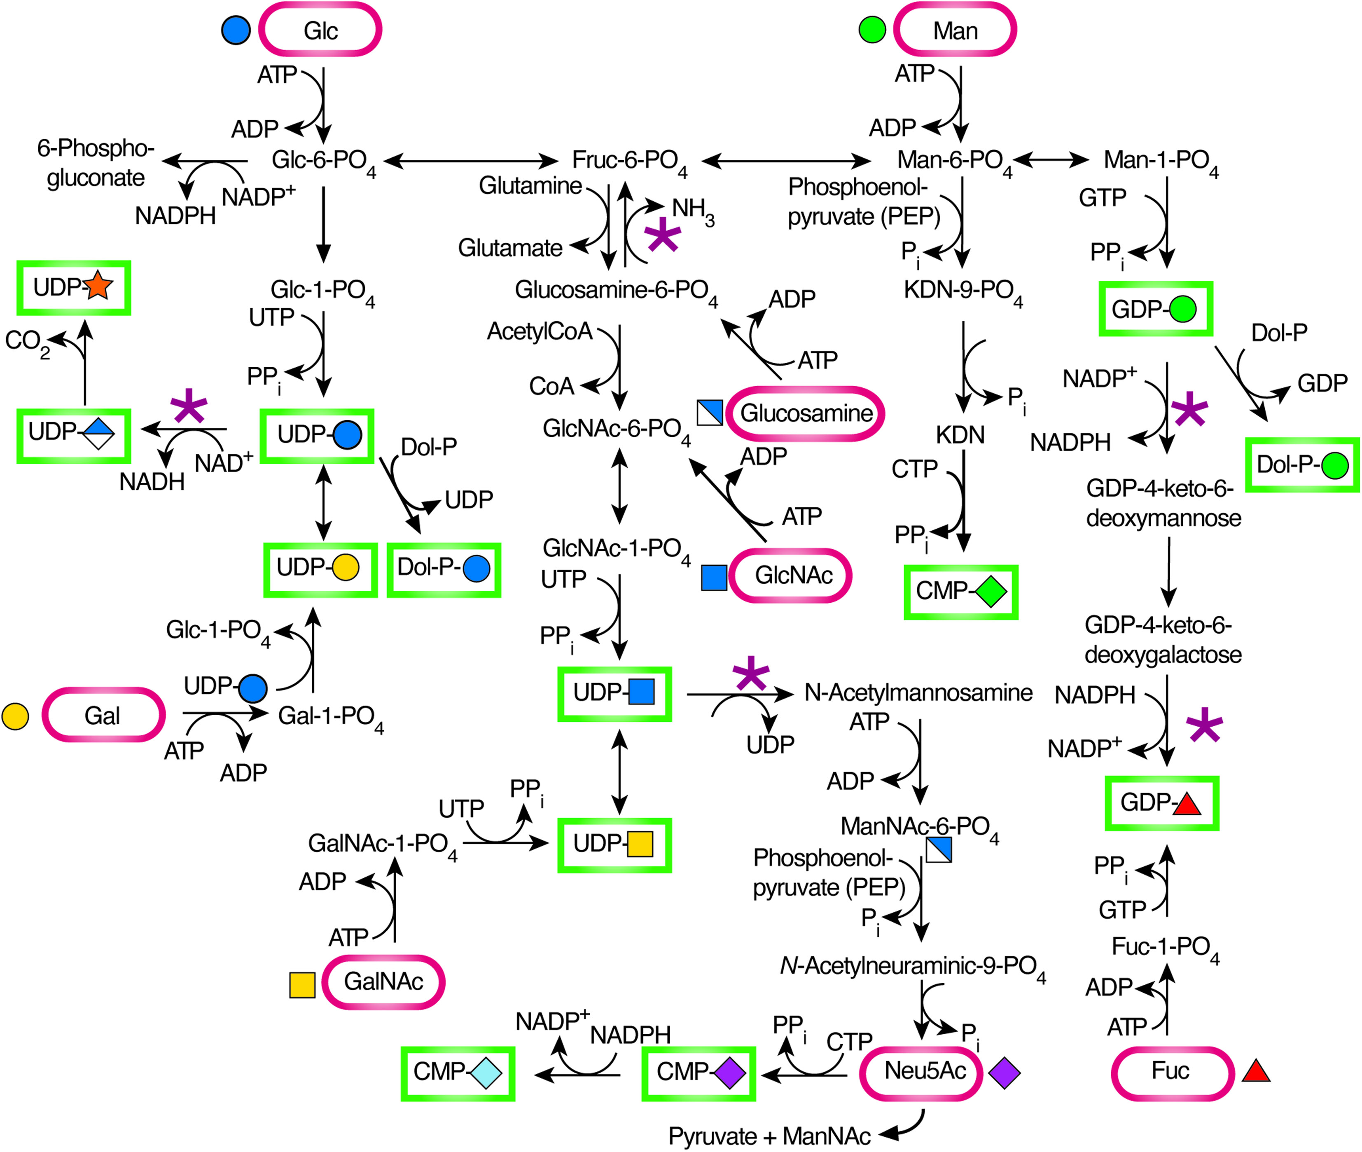
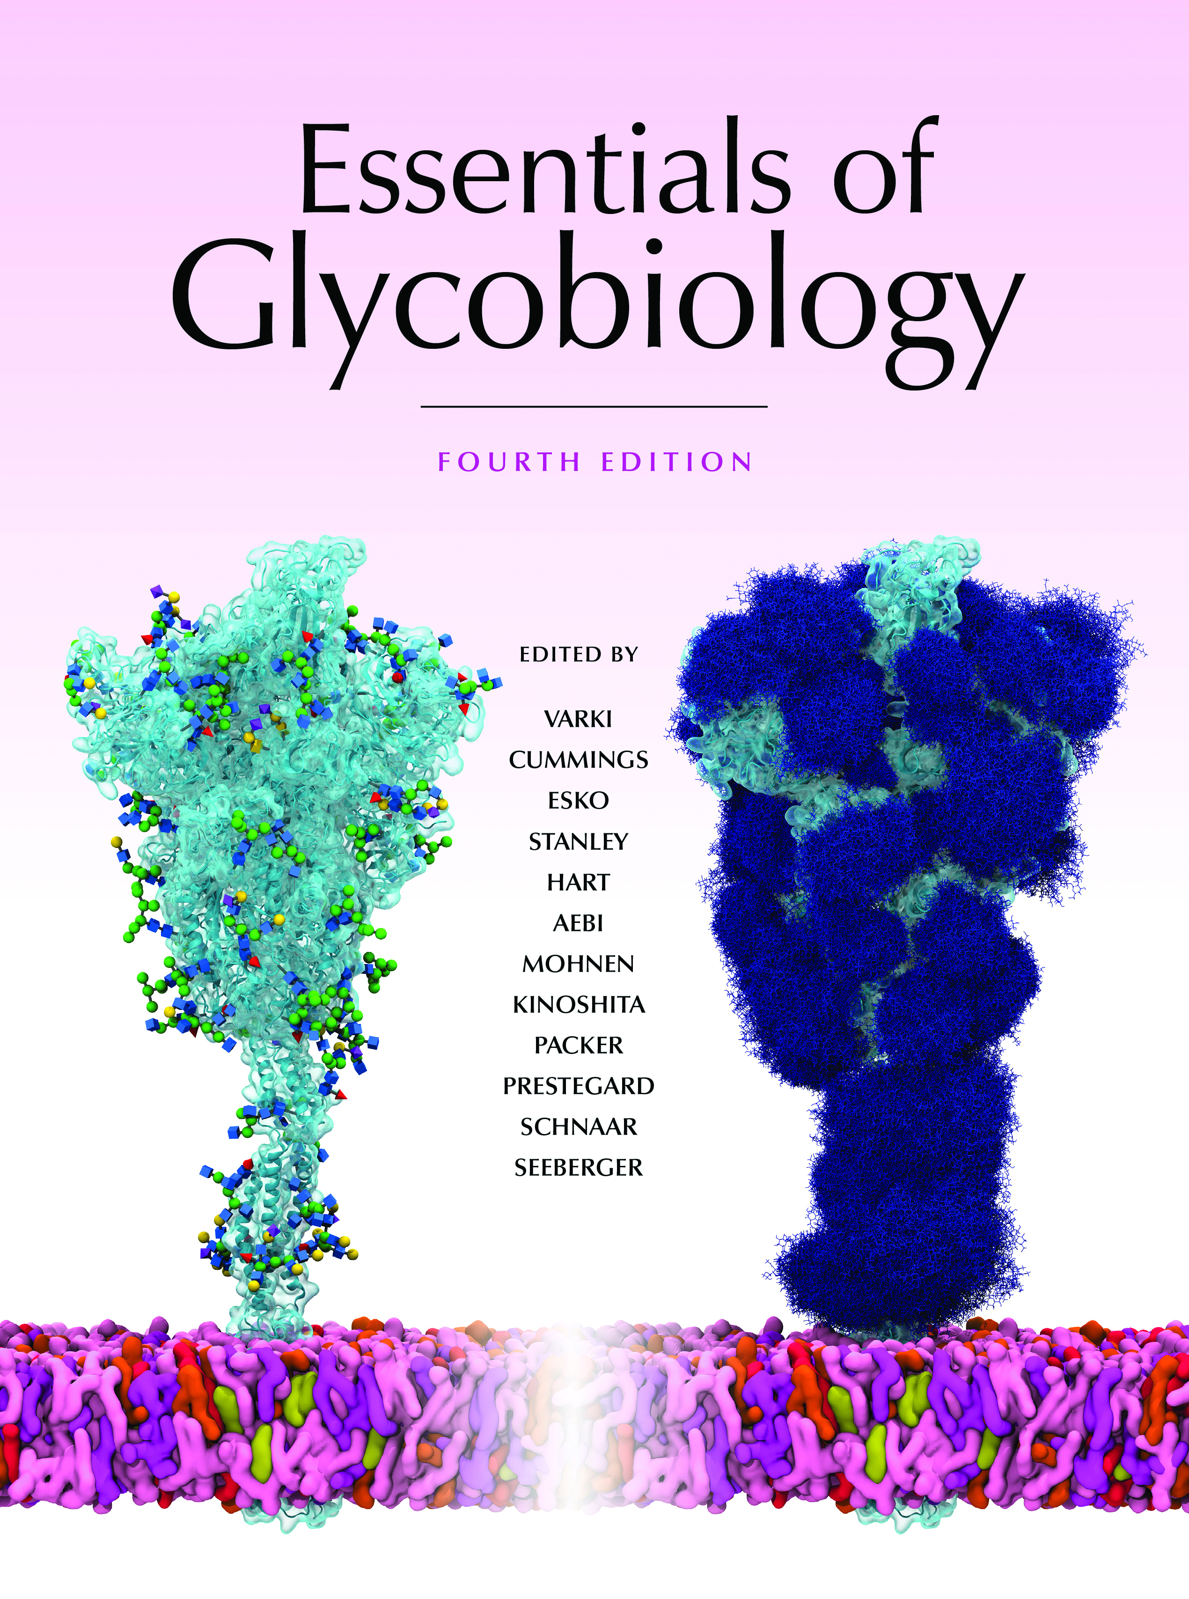


Biosynthesis and Interconversion of Monosaccharides
Chapter 5, Figure 1. Essentials of Glycobiology, Fourth Edition
Click here for Symbol Nomenclature for Glycans (SNFG) (Live only in slide display mode)
Buy the Book
©2022 The Consortium of Glycobiology Editors, La Jolla, California
Notes:
(Note: Embedded links are present but live only in the slide display mode.)
FIGURE 5.1. Biosynthesis and interconversion of monosaccharides. The relative contributions of each pathway under physiological conditions are unknown. (Rectangles) donors; (ovals) monosaccharides; (asterisks) control points; (Kdn) 2-keto-3-deoxy-D-glycero-D-galactonononic acid; (Dol) dolichol. See Online Appendix 1B for full names and designated symbols for monosaccharides.

Slide 2
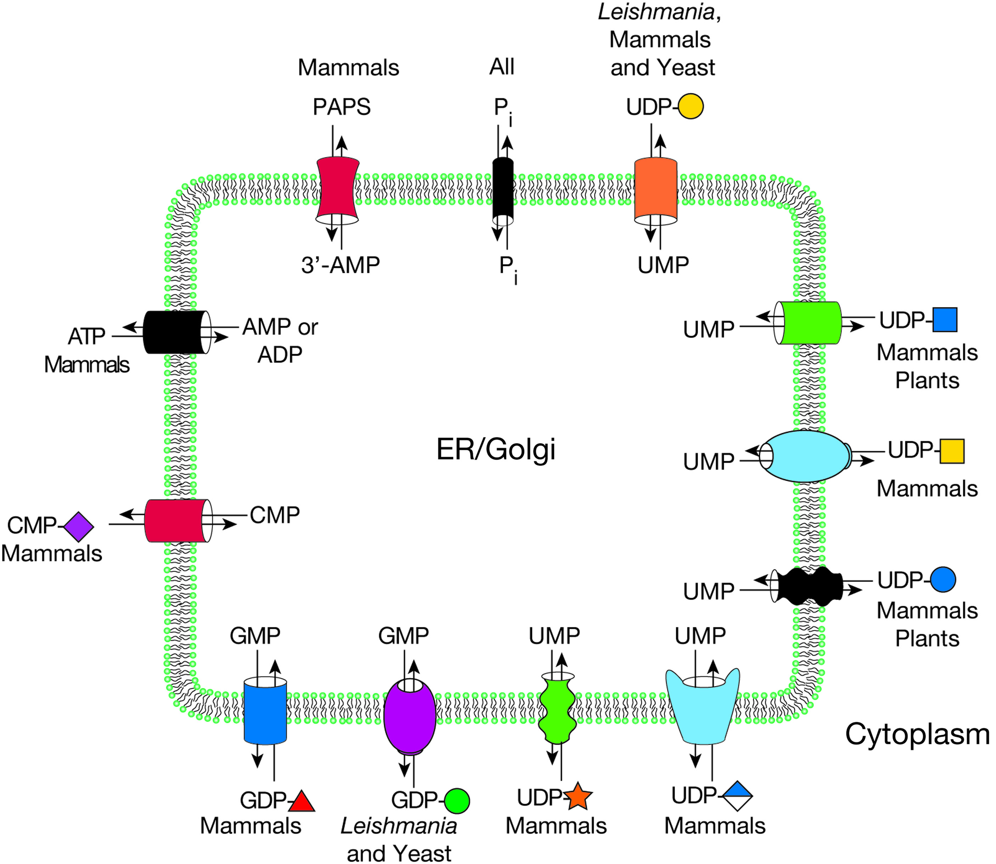
Some Known Transporters for Nucleotide Sugars, PAPS, and ATP
Chapter 5, Figure 4. Essentials of Glycobiology, Fourth Edition
Click here for Symbol Nomenclature for Glycans (SNFG) (Live only in slide display mode)
Buy the Book
©2022 The Consortium of Glycobiology Editors, La Jolla, California
Notes:
(Note: Embedded links are present but live only in the slide display mode.)
FIGURE 5.4. Some known transporters for nucleotide sugars, PAPS (3′-phosphoadenosine-5′-phosphosulfate), and ATP are located in the Golgi membranes of mammals, yeast, protozoa, and plants. These proteins are antiporters and return the corresponding nucleoside monophosphate back to the cytoplasm when the nucleotide sugar is delivered into the endoplasmic reticulum (ER) or Golgi compartment. Because most glycosylation reactions produce a nucleoside diphosphate, this requires conversion to the nucleoside monophosphate. For PAPS, the corresponding exiting molecule is unknown, and for ATP, it is AMP, ADP, or both. The phosphate (P_{i}) transporter is hypothetical. See Online Appendix 1B for full names and designated symbols for monosaccharides.

Slide 3
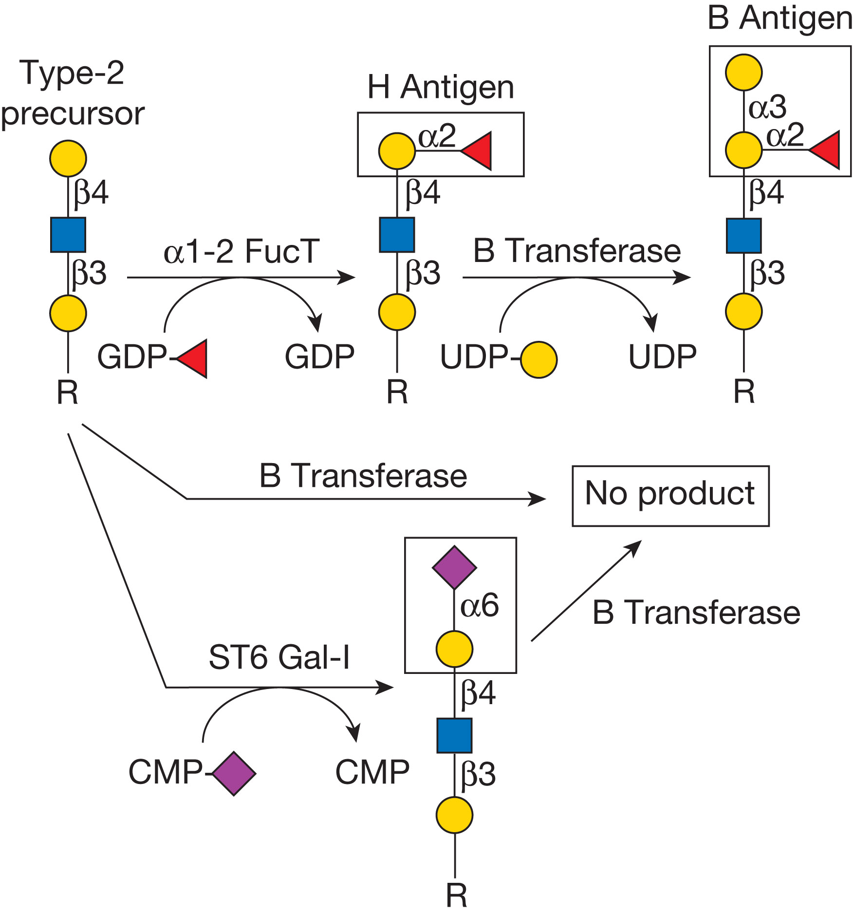
The Strict Acceptor Substrate Specificity of Glycosyltransferases
Chapter 6, Figure 1. Essentials of Glycobiology, Fourth Edition
Click here for Symbol Nomenclature for Glycans (SNFG) (Live only in slide display mode)
Buy the Book
©2022 The Consortium of Glycobiology Editors, La Jolla, California
Notes:
(Note: Embedded links are present but live only in the slide display mode.)
FIGURE 6.1. The strict acceptor substrate specificity of glycosyltransferases is illustrated by the human B blood group α1-3 galactosyltransferase. The B transferase adds galactose in α1-3-linkage to the H antigen (top middle) to form the B antigen (top right). This enzyme requires the α1-2-linked fucose modification of the H antigen for activity because the B transferase does not add to an unmodified type-2 precursor (top left) or precursors modified by sialyl residues (bottom) or other monosaccharides (not shown). (For the monosaccharide symbol code, see Figure 1.5.)

Slide 4
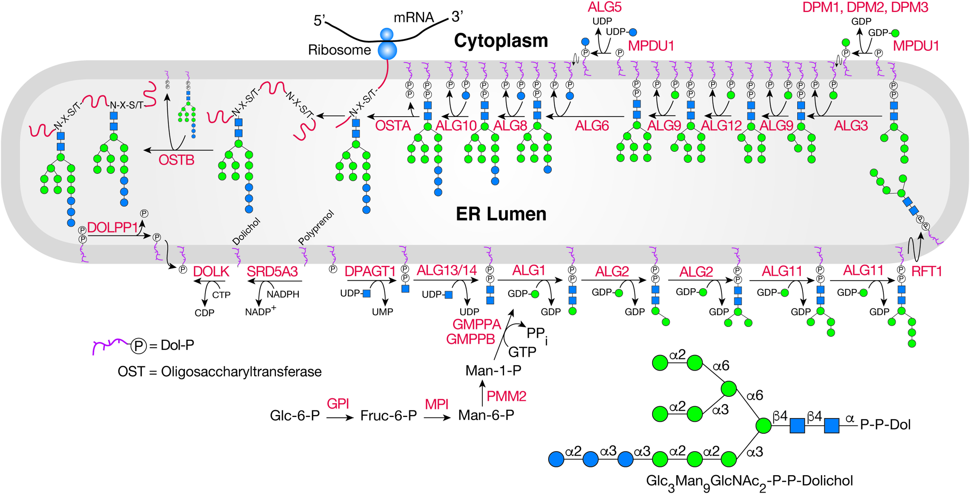
Synthesis of Dolichol-P-P-GlcNAc₂Man₉Glc₃
Chapter 9, Figure 3. Essentials of Glycobiology, Fourth Edition
Click here for Symbol Nomenclature for Glycans (SNFG) (Live only in slide display mode)
Buy the Book
©2022 The Consortium of Glycobiology Editors, La Jolla, California
Notes:
(Note: Embedded links are present but live only in the slide display mode.)
FIGURE 9.3. Synthesis of Dolichol-P-P-GlcNAc₂Man₉Glc₃. Dolichol (red squiggle) phosphate (Dol-P) located on the cytoplasmic face of the endoplasmic reticulum (ER) membrane receives GlcNAc-1-P from UDP-GlcNAc in the cytoplasm to generate Dol-P-P-GlcNAc. Dol-P-P-GlcNAc is extended to Dol-P-P-GlcNAc₂Man₅ before being “flipped” across the ER membrane to the lumenal side. Subsequently, four Man residues are added from Dol-P-Man and three Glc residues from Dol-P-Glc. Dol-P-Man and Dol-P-Glc are also made on the cytoplasmic side of the ER membrane and “flipped” onto the lumenal side. Yeast mutants defective in an alg (asparagine-linked glycosylation) gene were used to identify the ALG enzyme responsible for many reactions. The 14-sugar oligosaccharide is transferred to the Asn side chain within the sequon N-X-S/T by an oligosaccharyltransferase complex (OST) of 8-9 transmembrane proteins. In mammalian cells, the OSTA complex is associated with the translocon in the ER membrane and preferentially glycosylates nascent polypeptides traversing the translocon, whereas the OSTB complex modifies proteins that have left the translocon and are in the ER lumen. Enzyme names are from the Human Genome Nomenclature Committee (HGNC).

Slide 5
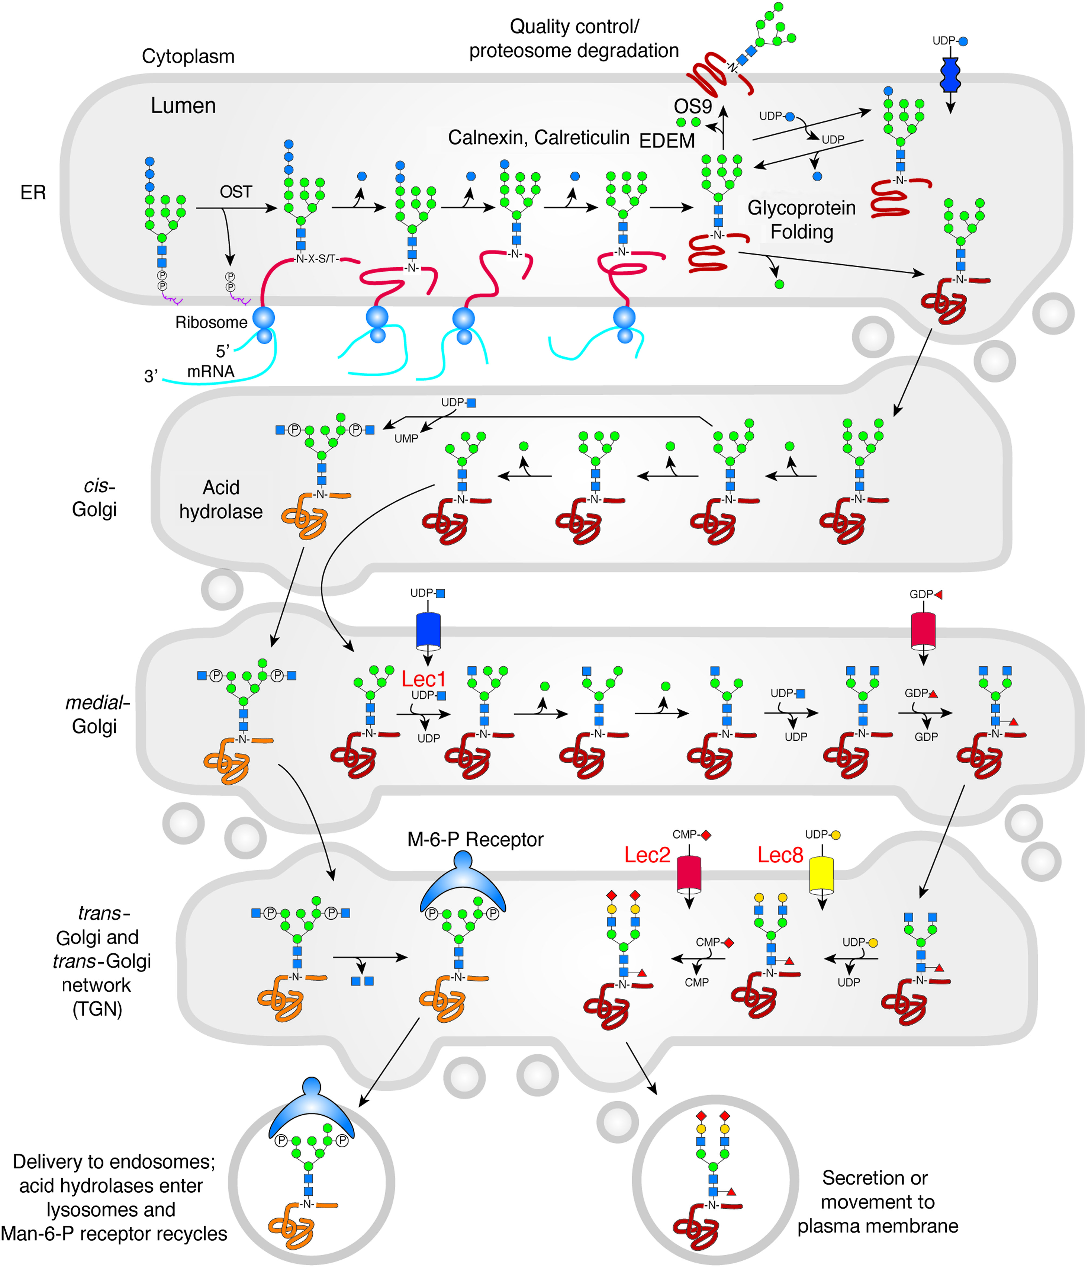
Processing and Maturation of an N-glycan
Chapter 9, Figure 4. Essentials of Glycobiology, Fourth Edition
Click here for Symbol Nomenclature for Glycans (SNFG) (Live only in slide display mode)
Buy the Book
©2022 The Consortium of Glycobiology Editors, La Jolla, California
Notes:
(Note: Embedded links are present but live only in the slide display mode.)
FIGURE 9.4. Processing and maturation of an N-glycan. The mature glycan attached to Dol-P-P (Figure 9.3) is usually transferred to Asn-X-Ser/Thr sequons during protein synthesis as proteins are being translocated into the endoplasmic reticulum (ER). Some transfer also occurs after translocation is complete. Following transfer of Glc₃Man₉GlcNAc₂ to protein, glucosidases in the ER remove three Glc residues, and ER mannosidase removes a Man residue. These reactions are intimately associated with the folding of the glycoprotein assisted by the lectins calnexin and calreticulin and the UDP-glucose:glycoprotein glucosyltransferase (UGGT), which together determine whether the glycoprotein with Man₉GlcNAc₂ continues to the Golgi or is degraded (Chapter 39). For misfolded proteins in the ER, mannose trimming by ER degradation-enhancing α-mannosidase I−like proteins (EDEMs) leads to formation of Man₇GlcNAc₂ N-glycans, which are recognized by the lectin OS9, which escorts them via retrotranslocation into the cytoplasm for degradation (Chapter 39). The removal of the first Glc (and therefore all Glc) can be experimentally blocked by castanospermine, leaving Glc₃Man₉GlcNAc₂, which may subsequently have terminal Man residues removed during passage through the Golgi. For most glycoproteins, additional Man residues are removed in the cis compartment of the Golgi by a family of mannosidases (MAN1A1, MAN1A2, MAN1C1) until Man₅GlcNAc₂ is generated. The mannosidase inhibitors deoxymannojirimycin and kifunensine block the removal of these Man residues, leaving Man₉GlcNAc₂, which is not further processed in the Golgi. The action of MGAT1 on Man₅GlcNAc₂ in the medial-Golgi initiates the first branch of a complex or hybrid N-glycan. This reaction is blocked in Lec1 CHO mutants in which MGAT1 is inactive, leaving Man₅GlcNAc₂, which is not further processed. α-Mannosidase II activity, catalyzed by MAN2A1 or MAN2A2, removes two outer Man residues in a reaction that may be blocked by the inhibitor swainsonine. The action of α-mannosidase II generates the substrate for MGAT2. The resulting biantennary N-glycan is extended by the addition of Fuc, Gal, and Sia to generate a complex N-glycan with two branches. The addition of Gal does not occur in Lec8 CHO mutants, which have an inactive UDP-Gal transporter. Thus, in Lec8 mutants, complex N-glycans terminate in GlcNAc. The addition of Sia does not occur in Lec2 CHO mutants, which have an inactive CMP-Sia transporter. In Lec2 mutants, complex N-glycans terminate in Gal. Complex N-glycans can have many more sugars than shown in this figure, including additional residues attached to the core, additional branches, branches extended with poly-LacNAc units, and different “capping” epitopes (Chapter 14). Also shown is the special case of lysosomal hydrolases that acquire a GlcNAc-1-P at C-6 of Man residues on oligomannose N-glycans in the cis-Golgi by N-acetylglucosamine-1-phosphotransferase (heterodimer of GNPTAB and GNPTG). The GlcNAc is removed in the trans-Golgi by a phosphodiester N-acetylglucosamindase (NAGPA), thereby exposing Man-6-P that is recognized by a Man-6-P receptor (M6PR) and routed to an acidified, prelysosomal compartment (Chapter 33). Chemical inhibitors of N-glycan processing are described in Chapter 55, and CHO mutants blocked in N-glycan synthesis are described in Chapter 49. (Adapted, with permission of the Annual Review of Biochemistry, from Kornfeld R, Kornfeld S. 1985. Annu Rev Biochem 54: 631−634.)

Slide 6
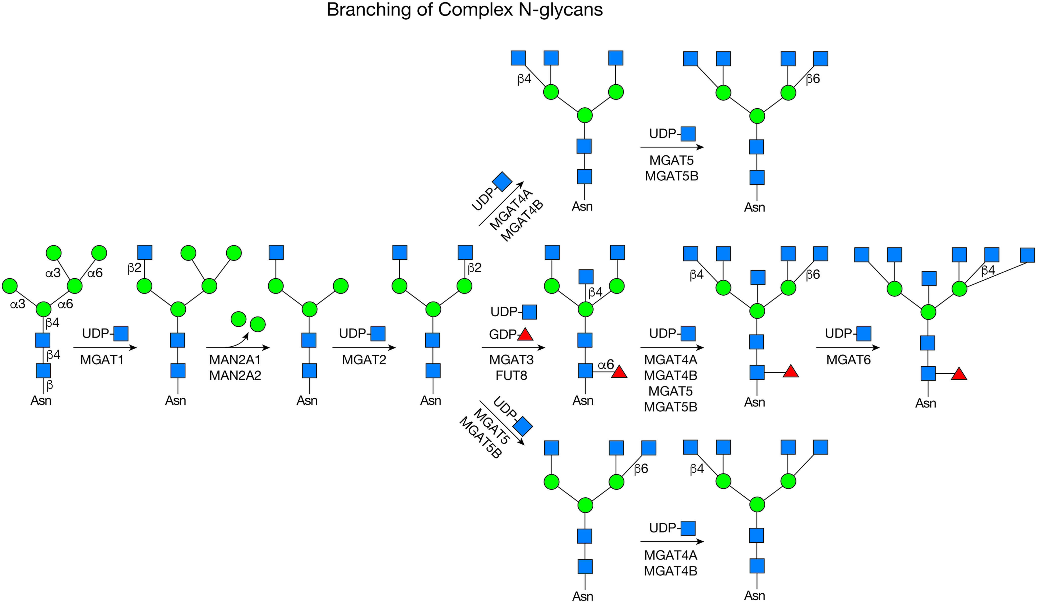
Branching and Core Modification of Complex N-glycans
Chapter 9, Figure 5. Essentials of Glycobiology, Fourth Edition
Click here for Symbol Nomenclature for Glycans (SNFG) (Live only in slide display mode)
Buy the Book
©2022 The Consortium of Glycobiology Editors, La Jolla, California
Notes:
(Note: Embedded links are present but live only in the slide display mode.)
FIGURE 9.5. Branching and core modification of complex N-glycans. The hybrid and mature, biantennary, complex N-glycans shown in Figure 9.4 may contain more branches because of GlcNAc-transferases in the Golgi that act only after MGAT1 has acted. If the α-mannosidase II enzymes, MAN2A1 or MAN2A2, do not act, a hybrid N-glycan results. When the mannosidases act, a biantennary N-glycan is generated by MGAT2. This substrate may accept the bisecting GlcNAc from MGAT3, or a Fuc from FUT8, or a GlcNAc from the branching enzymes MGAT4A, MGAT4B, MGAT5, or MGAT5B in mammals. MGAT6 is present in birds and fish and potentially mammals. Each GlcNAc branch may be elongated with Gal, GlcNAc, Sia, and Fuc (Figure 9.6 and Chapter 14). The bisecting GlcNAc is not usually elongated unless MGAT2 is missing. The core Fuc is not elongated in mammals. The linkage of the sugar transferred at each step is shown.

Slide 7
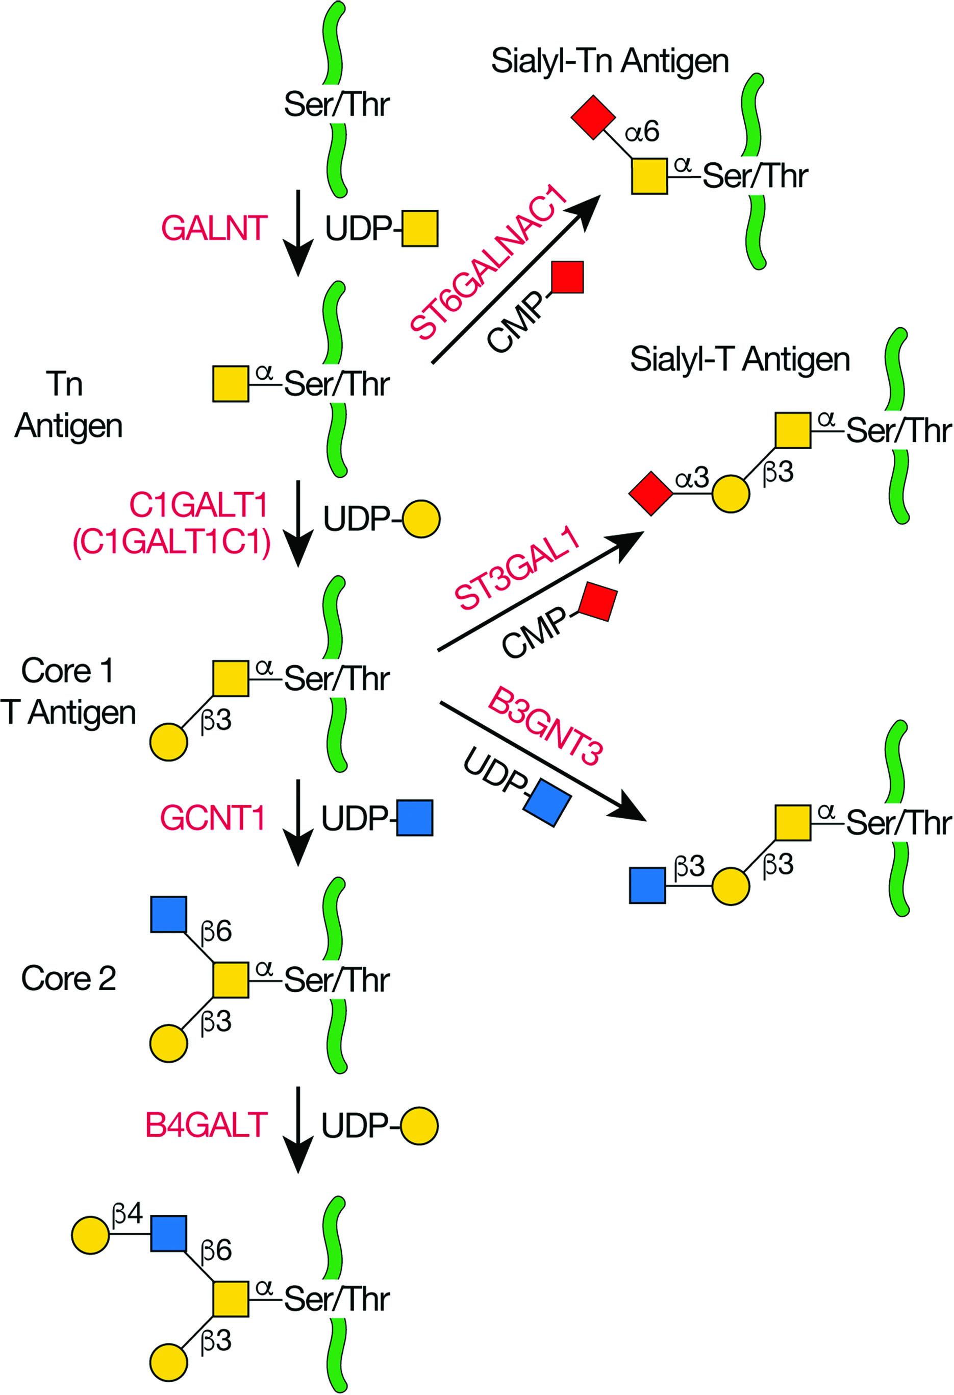
Biosynthesis of Core 1 and 2 O-GalNAc Glycans
Chapter 10, Figure 2. Essentials of Glycobiology, Fourth Edition
Click here for Symbol Nomenclature for Glycans (SNFG) (Live only in slide display mode)
Buy the Book
©2022 The Consortium of Glycobiology Editors, La Jolla, California
Notes:
(Note: Embedded links are present but live only in the slide display mode.)
FIGURE 10.2. Biosynthesis of core 1 and 2 O-GalNAc glycans as described in the text. Green lines are protein.

Slide 8
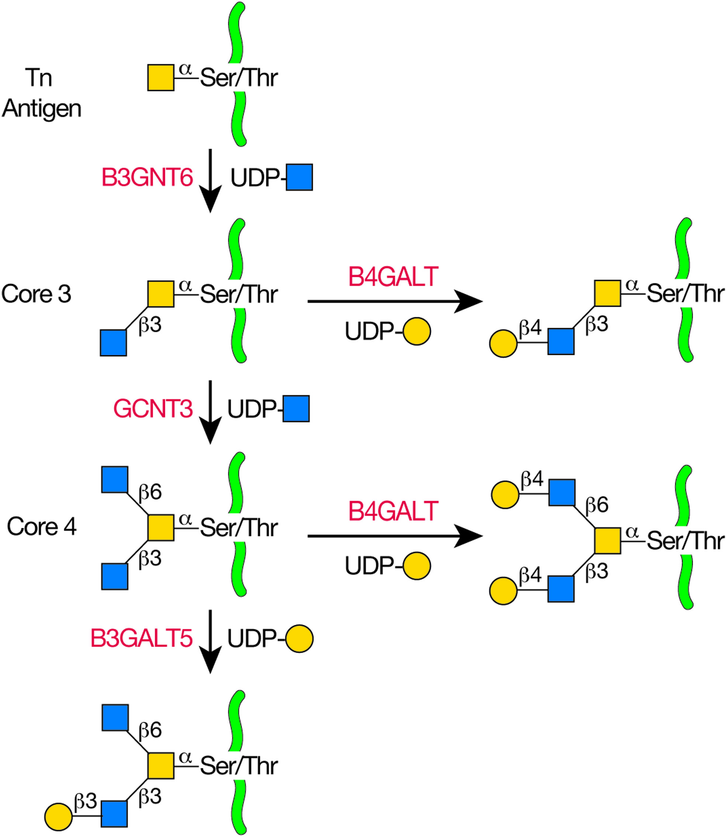
Biosynthesis of Core 3 and 4 O-GalNAc Glycans
Chapter 10, Figure 3. Essentials of Glycobiology, Fourth Edition
Click here for Symbol Nomenclature for Glycans (SNFG) (Live only in slide display mode)
Buy the Book
©2022 The Consortium of Glycobiology Editors, La Jolla, California
Notes:
(Note: Embedded links are present but live only in the slide display mode.)
FIGURE 10.3. Biosynthesis of core 3 and 4 O-GalNAc glycans as described in the text. Green lines are protein.

Slide 9
Glycosphingolipid (GSL) Neutral Cores and Their Designation Based on IUPAC Nomenclature
Chapter 11, Figure 2. Essentials of Glycobiology, Fourth Edition
Click here for Symbol Nomenclature for Glycans (SNFG) (Live only in slide display mode)
Buy the Book
©2022 The Consortium of Glycobiology Editors, La Jolla, California
Notes:
(Note: Embedded links are present but live only in the slide display mode.)
FIGURE 11.2. Glycosphingolipid (GSL) neutral cores and their designation based on IUPAC (International Union of Pure and Applied Chemistry) Nomenclature. In the official nomenclature, saccharide and other substituents that extend or branch from the neutral core structures are indicated by a roman numeral designating which of the neutral core sugars (counting the sugar closest to the ceramide as "I") carries the substituent, and a superscript designating which hydroxyl on that sugar is modified. For example, see ganglioside GT1b (IV³Neu5AcII³ [Neu5Ac] ₂Gg₄Cer) in Figure 11.1. See Online Appendix 1B for full names and designated symbols for monosaccharides.

Slide 10
GSLs Are Synthesized by the Stepwise Addition of Sugars
Chapter 11, Figure 3. Essentials of Glycobiology, Fourth Edition
Click here for Symbol Nomenclature for Glycans (SNFG) (Live only in slide display mode)
Buy the Book
©2022 The Consortium of Glycobiology Editors, La Jolla, California
Notes:
(Note: Embedded links are present but live only in the slide display mode.)
FIGURE 11.3. Glycosphingolipids (GSLs) are synthesized by the stepwise addition of sugars first to ceramide and then to the growing glycans. Shown as examples are major brain GSLs. Ceramide (Cer) is the acceptor for UDP-Gal:ceramide β-galactosyltransferase or UDP-Glc:ceramide β-glucosyltransferase in the major pathways to biosynthesis of the quantitatively major GSLs in oligodendrocytes (shaded pink) and nerve cells (shaded blue), respectively. GalCer is the acceptor for GalCer sulfotransferase, which adds a sulfate group to the C-3 of galactose to form sulfatide. Extension of GlcCer to the major brain gangliosides occurs by the action of UDP-Gal:GlcCer β1-4 galactosyltransferase to make lactosylceramide (LacCer) and then CMP-Neu5Ac:lactosylceramide α2-3 sialyltransferase to make the simple ganglioside GM3. GM3 is a branch point and acts as the acceptor for UDP-GalNAc:GM3/GD3 β1-4 N-acetylgalactosaminyltransferase to generate a-series gangliosides and for CMP-Neu5Ac:GM3 α2-8 sialyltransferase to generate GD3 and the b-series gangliosides. Similarly, the action of an α2-8 sialyltransferase on GD3 gives rise to GT3 and the c-series gangliosides. Enzymes for subsequent elongation are common to the a-, b-, and c-series gangliosides.

Slide 11
GPI-Biosynthetic Pathways
Chapter 12, Figure 2. Essentials of Glycobiology, Fourth Edition
Buy the Book
©2022 The Consortium of Glycobiology Editors, La Jolla, California
Notes:
(Note: Embedded links are present but live only in the slide display mode.)
FIGURE 12.2. Glycosylphosphatidylinositol (GPI)-biosynthetic pathways of Trypanosoma brucei, Saccharomyces cerevisiae, and mammals. These examples show that, despite the highly conserved core structure of GPI anchors, some diversity in GPI-biosynthesis exists. In particular, yeast and mammalian GPI intermediates are inositol-acylated at the level of GlcN-PI and are not deacylated until after transfer to protein, whereas T. brucei GPI intermediates are acylated at the level of Man-GlcN-PI and undergo rounds of deacylation and reacylation throughout the pathway. Mammalian GPI intermediates undergo a first round of lipid remodeling at the level of GlcN-aPI and then again after transport to the Golgi. S. cerevisiae GPI intermediates have a compulsory Man-4 added unlike in mammals and lipid remodeling of their GPI-APs occur in two consecutive steps within the endoplasmic reticulum (ER). The protein components of the pathway that catalyze these steps in mammals and S. cerevisiae are described in Table 12.1. Some of the T. brucei homologs are yet to be identified. The "?" refers to an unknown process. The double-headed arrows represent flipping of the GPI intermediate by an unknown mechanism. Dashed arrows denote probable alternative pathways or steps that are not compulsory.

Slide 12
Predicted Topologies of the ER-Resident Components of GPI Biosynthesis in Mammalian Cells
Chapter 12, Figure 3. Essentials of Glycobiology, Fourth Edition
Buy the Book
©2022 The Consortium of Glycobiology Editors, La Jolla, California
Notes:
(Note: Embedded links are present but live only in the slide display mode.)
FIGURE 12.3. Predicted topologies of the ER-resident components of glycosylphosphatidylinositol (GPI) biosynthesis in mammalian cells. Components within boxes belong to multisubunit complexes. The step numbers refer to those in Figure 12.2 and Table 12.1. The topologies of the "multispanning" membrane proteins are mostly those predicted by bioinformatics methods. N, amino terminus; ER, endoplasmic reticulum.

Slide 13
Modifications of Epidermal Growth Factor (EGF) Repeats
Chapter 13, Figure 1. Essentials of Glycobiology, Fourth Edition
Click here for Symbol Nomenclature for Glycans (SNFG) (Live only in slide display mode)
Buy the Book
©2022 The Consortium of Glycobiology Editors, La Jolla, California
Notes:
(Note: Embedded links are present but live only in the slide display mode.)
FIGURE 13.1. Modifications of epidermal growth factor (EGF) repeats. (A) EGF repeats can be modified by O-fucose, O-glucose, and O-GlcNAc. A schematic representation of an EGF repeat is shown: (yellow) conserved Cys residues; (gray lines between the cysteines) disulfide-bonding pattern. The modification sites for O-glucose (blue), O-fucose (red), and O-GlcNAc (dark blue) are shown in the context of the consensus sequences for each. S, serine; S¹, POGLUT1 modification site; S^{2,3}, POGLUT2/3 modification site; T, Thr; P, Pro; A, Ala; G, Gly; N, Asn; F, Phe; X, any amino acid. (Modified, with permission, from Haltiwanger RS. 2004. In Encyclopedia of Biological Chemistry, Vol. 2, pp. 277–282, © Elsevier.) (B) EGF repeat O-glycan synthesis in mammals. The largest known structure for O-fucose, O-glucose, and O-GlcNAc glycans on EGF repeats is shown, and the enzyme responsible for the addition of each sugar is indicated.

Slide 14
Biosynthetic Pathway of O-Mannose Glycans
Chapter 13, Figure 5. Essentials of Glycobiology, Fourth Edition
Click here for Symbol Nomenclature for Glycans (SNFG) (Live only in slide display mode)
Buy the Book
©2022 The Consortium of Glycobiology Editors, La Jolla, California
Notes:
(Note: Embedded links are present but live only in the slide display mode.)
FIGURE 13.5. Biosynthetic pathway of O-mannose glycans. The O-mannose glycans belong to three core classes depending on extension from protein-linked mannose by a sole β1-2GlcNAc (core M1), by two GlcNAcs in β1-2 and β1-6 linkages (core M2), or by β1-4GlcNAc (core M3). Further elaboration of all three core classes can occur by extensions from the mannose as shown. Core M3 glycans may be specific for α-dystroglycan in mammals, and usually carry the repeating disaccharide matriglycan transferred by LARGE that is required for laminin binding.

Slide 15
Terminal GlcNAc Residues Are Usually Galactosylated
Chapter 14, Figure 2. Essentials of Glycobiology, Fourth Edition
Click here for Symbol Nomenclature for Glycans (SNFG) (Live only in slide display mode)
Buy the Book
©2022 The Consortium of Glycobiology Editors, La Jolla, California
Notes:
(Note: Embedded links are present but live only in the slide display mode.)
FIGURE 14.2. Terminal GlcNAc residues are usually galactosylated. Modification by β 1-4Gal (top) occurs in all mammalian tissues. This reaction is catalyzed by β 1-4 galactosyltransferases (B4GALT1 to B4GALT6) and yields the Gaβ1-4GlcNAc (N-acetyllactosamine) unit termed Type-2. Transfer of β 1-3Gal residues (bottom) is restricted to certain tissues. This reaction is catalyzed by β 1-3 galactosyltransferase (B3GALT1, 2, 4, and 5) and yields the Galβ1-3GlcNAc unit termed Type-1. R indicates N- and O-glycans or glycolipids. Type-2 and -1 units can be further modified by subsequent glycosylation reactions. Poly-N-acetyllactosamine chain initiation is catalyzed by β 1-3 N-acetylglucosaminyltransferases (B3GNT2 to B3GNT8).

Slide 16
Blood Group i and I Antigen Synthesis
Chapter 14, Figure 3. Essentials of Glycobiology, Fourth Edition
Click here for Symbol Nomenclature for Glycans (SNFG) (Live only in slide display mode)
Buy the Book
©2022 The Consortium of Glycobiology Editors, La Jolla, California
Notes:
(Note: Embedded links are present but live only in the slide display mode.)
FIGURE 14.3. Blood group i and I antigen synthesis. Linear poly-N-acetyllactosamine chains (i antigen) synthesized on N- and O-glycans or glycolipids (R) may be modified by a β1-6 N-acetylglucosaminyltransferase (GCNT2 or GCNT3). These enzymes transfer GlcNAc in β1-6 linkage to internal Gal residues. The newly added β1-6 N-acetylglucosamine branch (I antigen) may serve as substrate for subsequent poly-N-acetyllactosamine biosynthesis (Figure 14.2). (LN) N-acetyllactosamine unit.

Slide 17
Blood Group Determinants on Glycolipids
Chapter 14, Figure 4. Essentials of Glycobiology, Fourth Edition
Click here for Symbol Nomenclature for Glycans (SNFG) (Live only in slide display mode)
Buy the Book
©2022 The Consortium of Glycobiology Editors, La Jolla, California
Notes:
(Note: Embedded links are present but live only in the slide display mode.)
FIGURE 14.4. Type-1, -2, and -3 H, A, and B antigens that form the O (H), A, and B blood group determinants on N- and O-glycans. Type-4 H, A, and B antigens form the O (H), A, and B blood group determinants on glycolipids.

Slide 18
Synthesis of H (O), A, and B Blood Group Determinants
Chapter 14, Figure 5. Essentials of Glycobiology, Fourth Edition
Click here for Symbol Nomenclature for Glycans (SNFG) (Live only in slide display mode)
Buy the Book
©2022 The Consortium of Glycobiology Editors, La Jolla, California
Notes:
(Note: Embedded links are present but live only in the slide display mode.)
FIGURE 14.5. Synthesis of H (O), A, and B blood group determinants. For details, see text. LN designates N-acetyllactosamine unit.

Slide 19
Type-1 and -2 Lewis Determinants
Chapter 14, Figure 6. Essentials of Glycobiology, Fourth Edition
Click here for Symbol Nomenclature for Glycans (SNFG) (Live only in slide display mode)
Buy the Book
©2022 The Consortium of Glycobiology Editors, La Jolla, California
Notes:
(Note: Embedded links are present but live only in the slide display mode.)
FIGURE 14.6. Type-1 and -2 Lewis determinants. Type-1 and -2 units differ in the linkage of the outermost galactose (β1-3 or β1-4, respectively), and thus in the linkage of fucose to the internal GlcNAc (α1-4 or α1-3, respectively). R represents N- or O-glycan or glycolipid. Lewis x determinants may contain sulfate at C3 or C6 of Gal and at C6 of GlcNAc. The 6-O-sulfated GlcNAc is necessary for lymphocyte homing to peripheral lymph nodes. The Type-1 Lewis blood group determinants on glycoproteins and glycolipids (R) are characterized by the presence or absence of the fucosyltransferases FUT2 and FUT3.

Slide 20
Biosynthesis of Antigens of the P1PK Blood Group System
Chapter 14, Figure 7. Essentials of Glycobiology, Fourth Edition
Click here for Symbol Nomenclature for Glycans (SNFG) (Live only in slide display mode)
Buy the Book
©2022 The Consortium of Glycobiology Editors, La Jolla, California
Notes:
(Note: Embedded links are present but live only in the slide display mode.)
FIGURE 14.7. Biosynthesis of antigens of the P1PK blood group system: P^{k}, P, and P1.

Slide 21
Structure and Synthesis of the Galα1-3Gal Antigen
Chapter 14, Figure 8. Essentials of Glycobiology, Fourth Edition
Click here for Symbol Nomenclature for Glycans (SNFG) (Live only in slide display mode)
Buy the Book
©2022 The Consortium of Glycobiology Editors, La Jolla, California
Notes:
(Note: Embedded links are present but live only in the slide display mode.)
FIGURE 14.8. Structure and synthesis of the Galα1-3Gal antigen. The α1-3GalT uses unsubstituted Type-2 units on glycoproteins or glycolipids (R) to form the Galα1-3Gal terminal epitope. The glycolipid globoside serves as the substrate for the Forssman α1-3GalNAcT (GBGT1) that forms globopentosylceramide, also termed the Forssman glycolipid.

Slide 22
Structure and Synthesis of N-Glycans Bearing Terminal GalNAc
Chapter 14, Figure 9. Essentials of Glycobiology, Fourth Edition
Click here for Symbol Nomenclature for Glycans (SNFG) (Live only in slide display mode)
Buy the Book
©2022 The Consortium of Glycobiology Editors, La Jolla, California
Notes:
(Note: Embedded links are present but live only in the slide display mode.)
FIGURE 14.9. Structure and synthesis of N-glycans bearing terminal GalNAc, including those with sulfated-GalNAc found on the pituitary hormones lutropin (LH) and thyrotropin (TSH), but not on follicle-stimulating hormone (FSH)

Slide 23
Synthesis of the Human Sdª or Mouse CT Antigen and the Glycolipid GM2
Chapter 14, Figure 10. Essentials of Glycobiology, Fourth Edition
Click here for Symbol Nomenclature for Glycans (SNFG) (Live only in slide display mode)
Buy the Book
©2022 The Consortium of Glycobiology Editors, La Jolla, California
Notes:
(Note: Embedded links are present but live only in the slide display mode.)
FIGURE 14.10. Synthesis of the human Sdª or mouse CT antigen and the glycolipid GM2.

Slide 24
Synthesis of α2-6 and α2-3 Sialic Acid on
O-Glycans and Glycolipids
Chapter 14, Figure 11. Essentials of Glycobiology, Fourth Edition
Click here for Symbol Nomenclature for Glycans (SNFG) (Live only in slide display mode)
Buy the Book
©2022 The Consortium of Glycobiology Editors, La Jolla, California
Notes:
(Note: Embedded links are present but live only in the slide display mode.)
FIGURE 14.11. Synthesis of α2-6 and α2-3 sialic acid on O-glycans and glycolipids (see Chapters 9 and 10) by the ST3Gal and ST6GalNAc families of sialyltransferases. Enzymes in parentheses contribute at relatively low levels in vitro to the reactions indicated.

Slide 25
Structure and Synthesis of Glycans with α2-8 Sialic Acids
Chapter 14, Figure 12. Essentials of Glycobiology, Fourth Edition
Click here for Symbol Nomenclature for Glycans (SNFG) (Live only in slide display mode)
Buy the Book
©2022 The Consortium of Glycobiology Editors, La Jolla, California
Notes:
(Note: Embedded links are present but live only in the slide display mode.)
FIGURE 14.12. Structure and synthesis of glycans with α2-8 sialic acids including polySia on N-glycans by ST8SIA1 to ST8SIA6. Synthesis and structure of the HNK-1 epitope. (GlucuronosylT) Glucuronosyltransferase, (SulfoT) sulfotransferase.

Slide 26
Structure and Synthesis of Glycans with α2-8 Sialic Acids
Chapter 14, Figure 12. Essentials of Glycobiology, Fourth Edition
Click here for Symbol Nomenclature for Glycans (SNFG) (Live only in slide display mode)
Buy the Book
©2022 The Consortium of Glycobiology Editors, La Jolla, California
Notes:
(Note: Embedded links are present but live only in the slide display mode.)
FIGURE 14.12. Structure and synthesis of glycans with α2-8 sialic acids including polySia on N-glycans by ST8SIA1 to ST8SIA6. Synthesis and structure of the HNK-1 epitope. (GlucuronosylT) Glucuronosyltransferase, (SulfoT) sulfotransferase.

Slide 27
Structure and Synthesis of Glycans with α2-8 Sialic Acids
Chapter 14, Figure 12. Essentials of Glycobiology, Fourth Edition
Click here for Symbol Nomenclature for Glycans (SNFG) (Live only in slide display mode)
Buy the Book
©2022 The Consortium of Glycobiology Editors, La Jolla, California
Notes:
(Note: Embedded links are present but live only in the slide display mode.)
FIGURE 14.12. Structure and synthesis of glycans with α2-8 sialic acids including polySia on N-glycans by ST8SIA1 to ST8SIA6. Synthesis and structure of the HNK-1 epitope. (GlucuronosylT) Glucuronosyltransferase, (SulfoT) sulfotransferase.

Slide 28
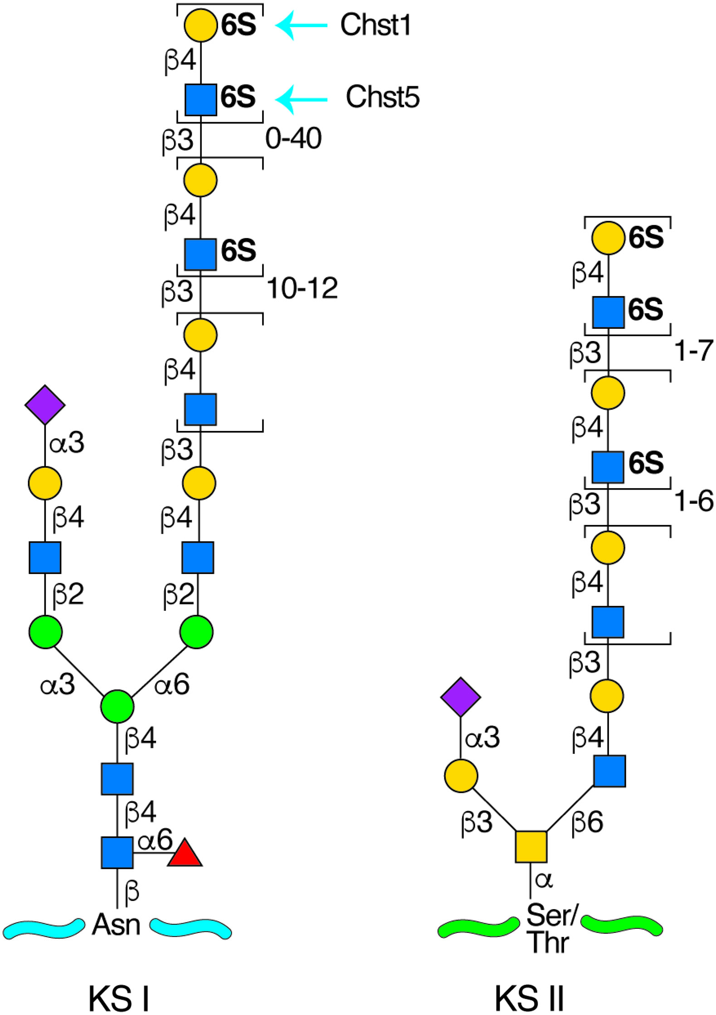
Keratan Sulfates (KS) Contain a Sulfated Poly-N-Acetyllactosamine Chain, Linked to Either Asparagine or Serine/Threonine Residues
Chapter 17, Figure 3. Essentials of Glycobiology, Fourth Edition
Click here for Symbol Nomenclature for Glycans (SNFG) (Live only in slide display mode)
Buy the Book
©2022 The Consortium of Glycobiology Editors, La Jolla, California
Notes:
(Note: Embedded links are present but live only in the slide display mode.)
FIGURE 17.3. Keratan sulfates (KS) contain a sulfated poly-N-acetyllactosamine chain, linked to either asparagine or serine/threonine residues. Chst1 and 5 can add sulfate groups at the indicated positions. The actual order of the various sulfated and nonsulfated disaccharides occurs somewhat randomly along the chain.

Slide 29
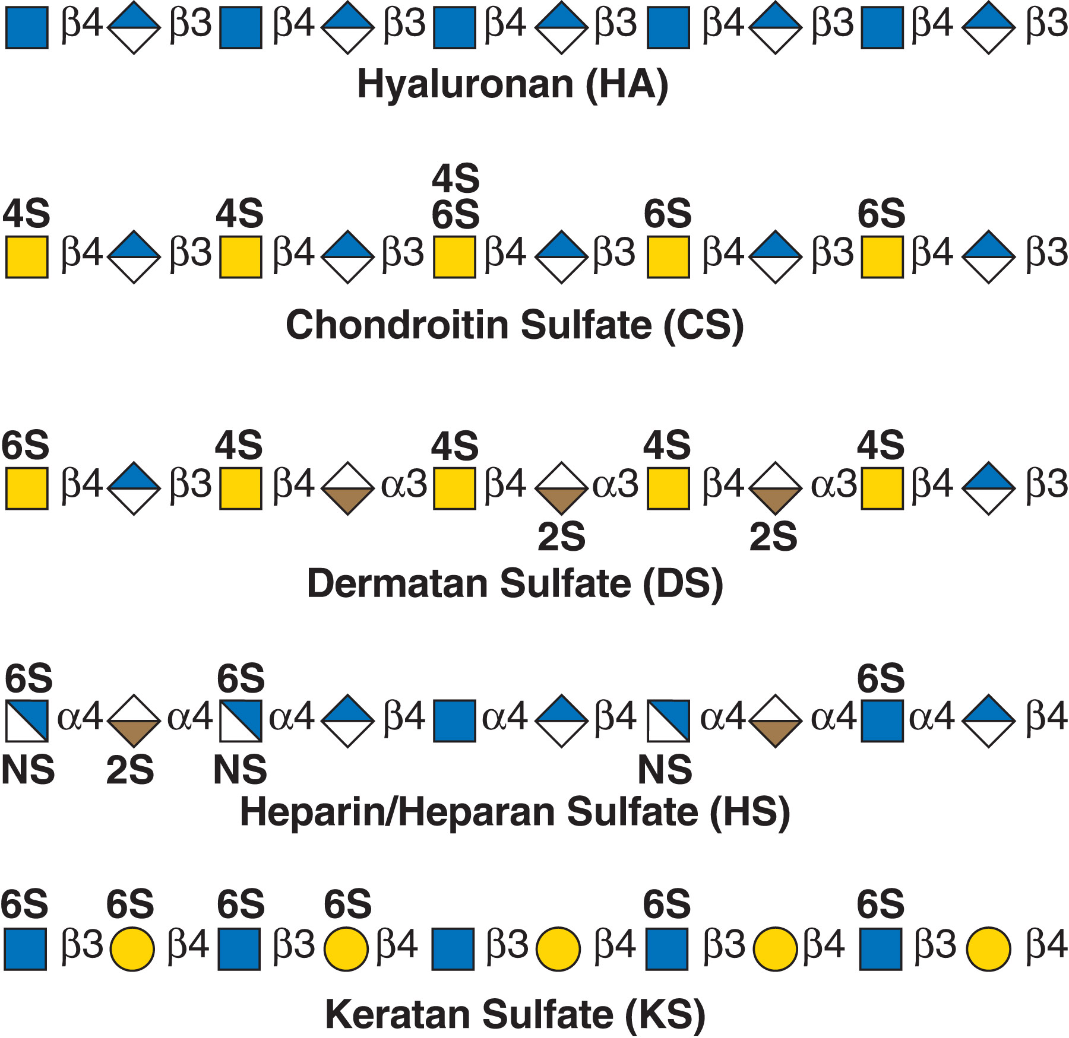
Glycosaminoglycans Consist of Alternating N-Acetylated (GlcNAc or GalNAc) or N-Sulfated (GlcNS) Glucosamine and Either a Uronic Acid (GlcA or IdoA) or Galactose (Gal)
Chapter 17, Figure 2. Essentials of Glycobiology, Fourth Edition
Click here for Symbol Nomenclature for Glycans (SNFG) (Live only in slide display mode)
Buy the Book
©2022 The Consortium of Glycobiology Editors, La Jolla, California
Notes:
(Note: Embedded links are present but live only in the slide display mode.)
FIGURE 17.2. Glycosaminoglycans consist of alternating N-acetylated (GlcNAc or GalNAc) or N-sulfated (GlcNS) glucosamine and either a uronic acid (GlcA or IdoA) or galactose (Gal). Hyaluronan lacks sulfate groups, but the rest of the glycosaminoglycans contain sulfates at various positions. Dermatan sulfate is distinguished from chondroitin sulfate by the presence of IdoA. Heparan sulfate and heparin are the only glycosaminoglycans that contain an N-sulfated hexosamine. Keratan sulfates lack uronic acids and instead consist of sulfated galactose and N-acetylglucosamine residues. Reducing termini are to the right in all sequences.

Slide 30
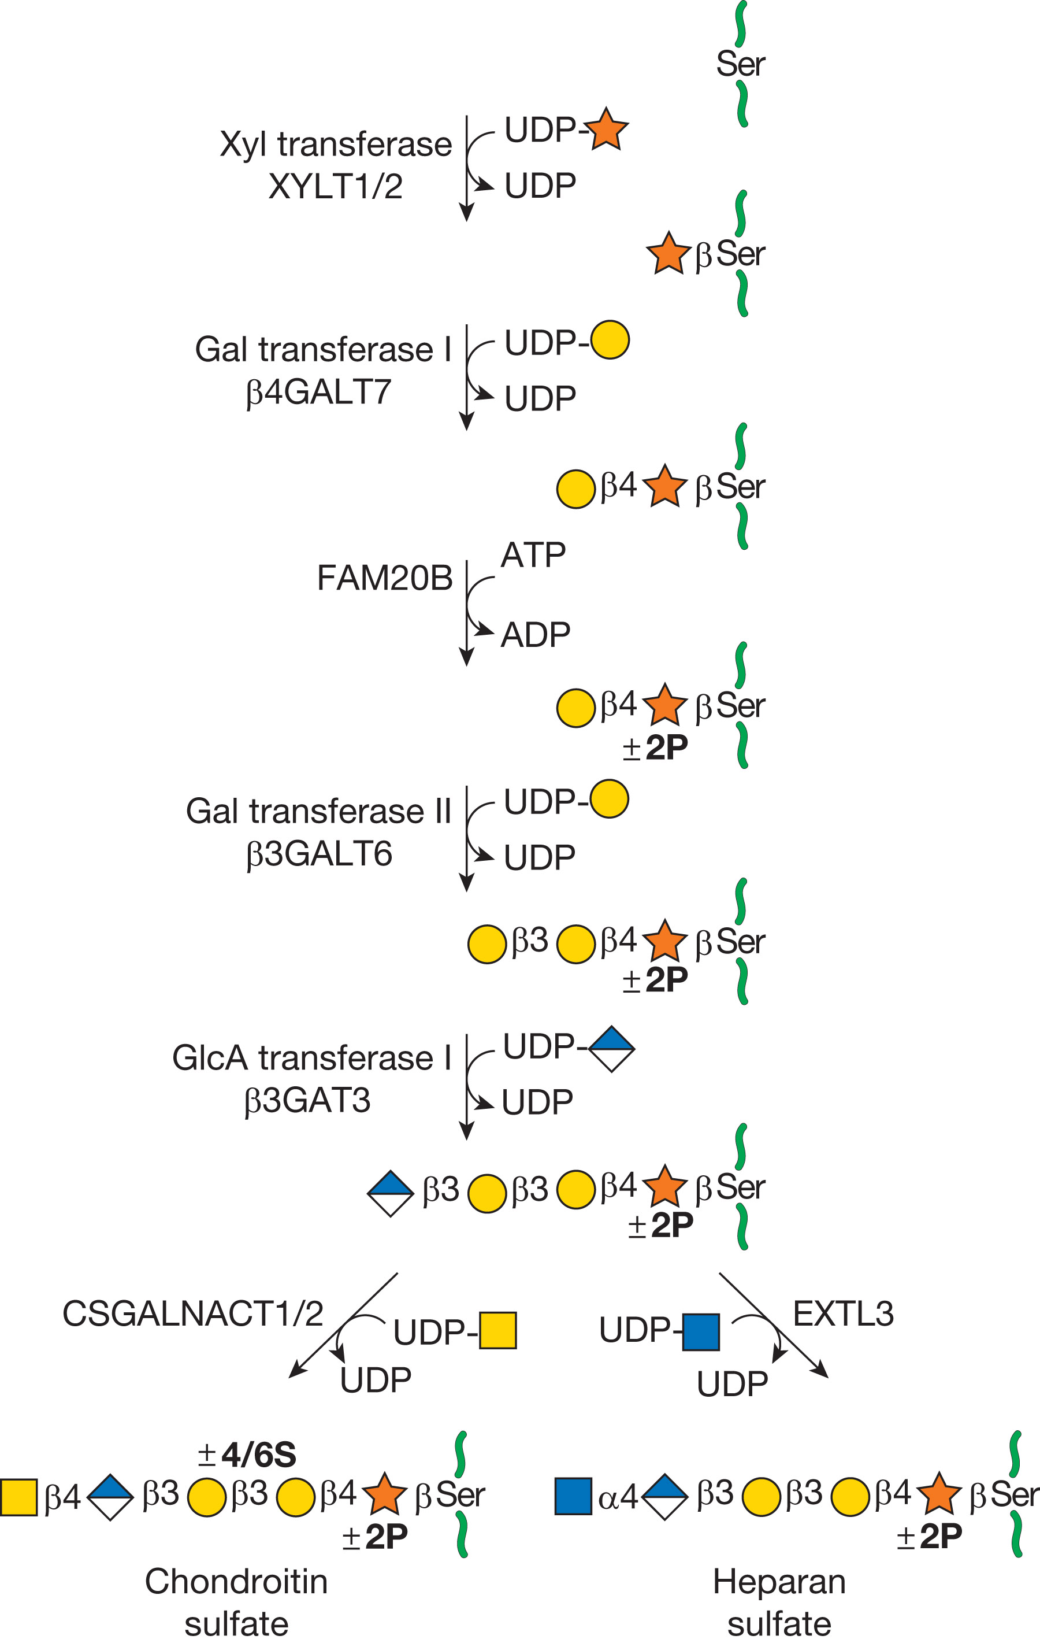
The Biosynthesis of Chondroitin Sulfate and Heparan Sulfate
Chapter 17, Figure 4. Essentials of Glycobiology, Fourth Edition
Click here for Symbol Nomenclature for Glycans (SNFG) (Live only in slide display mode)
Buy the Book
©2022 The Consortium of Glycobiology Editors, La Jolla, California
Notes:
(Note: Embedded links are present but live only in the slide display mode.)
FIGURE 17.4. The biosynthesis of chondroitin sulfate (left chain) and heparan sulfate (right chain) is initiated by the formation of a linkage region tetrasaccharide (green circles in Fig. 17.1). Addition of the first hexosamine commits the intermediate to either chondroitin sulfate (GalNAc) or heparan sulfate (GlcNAc).

Slide 31
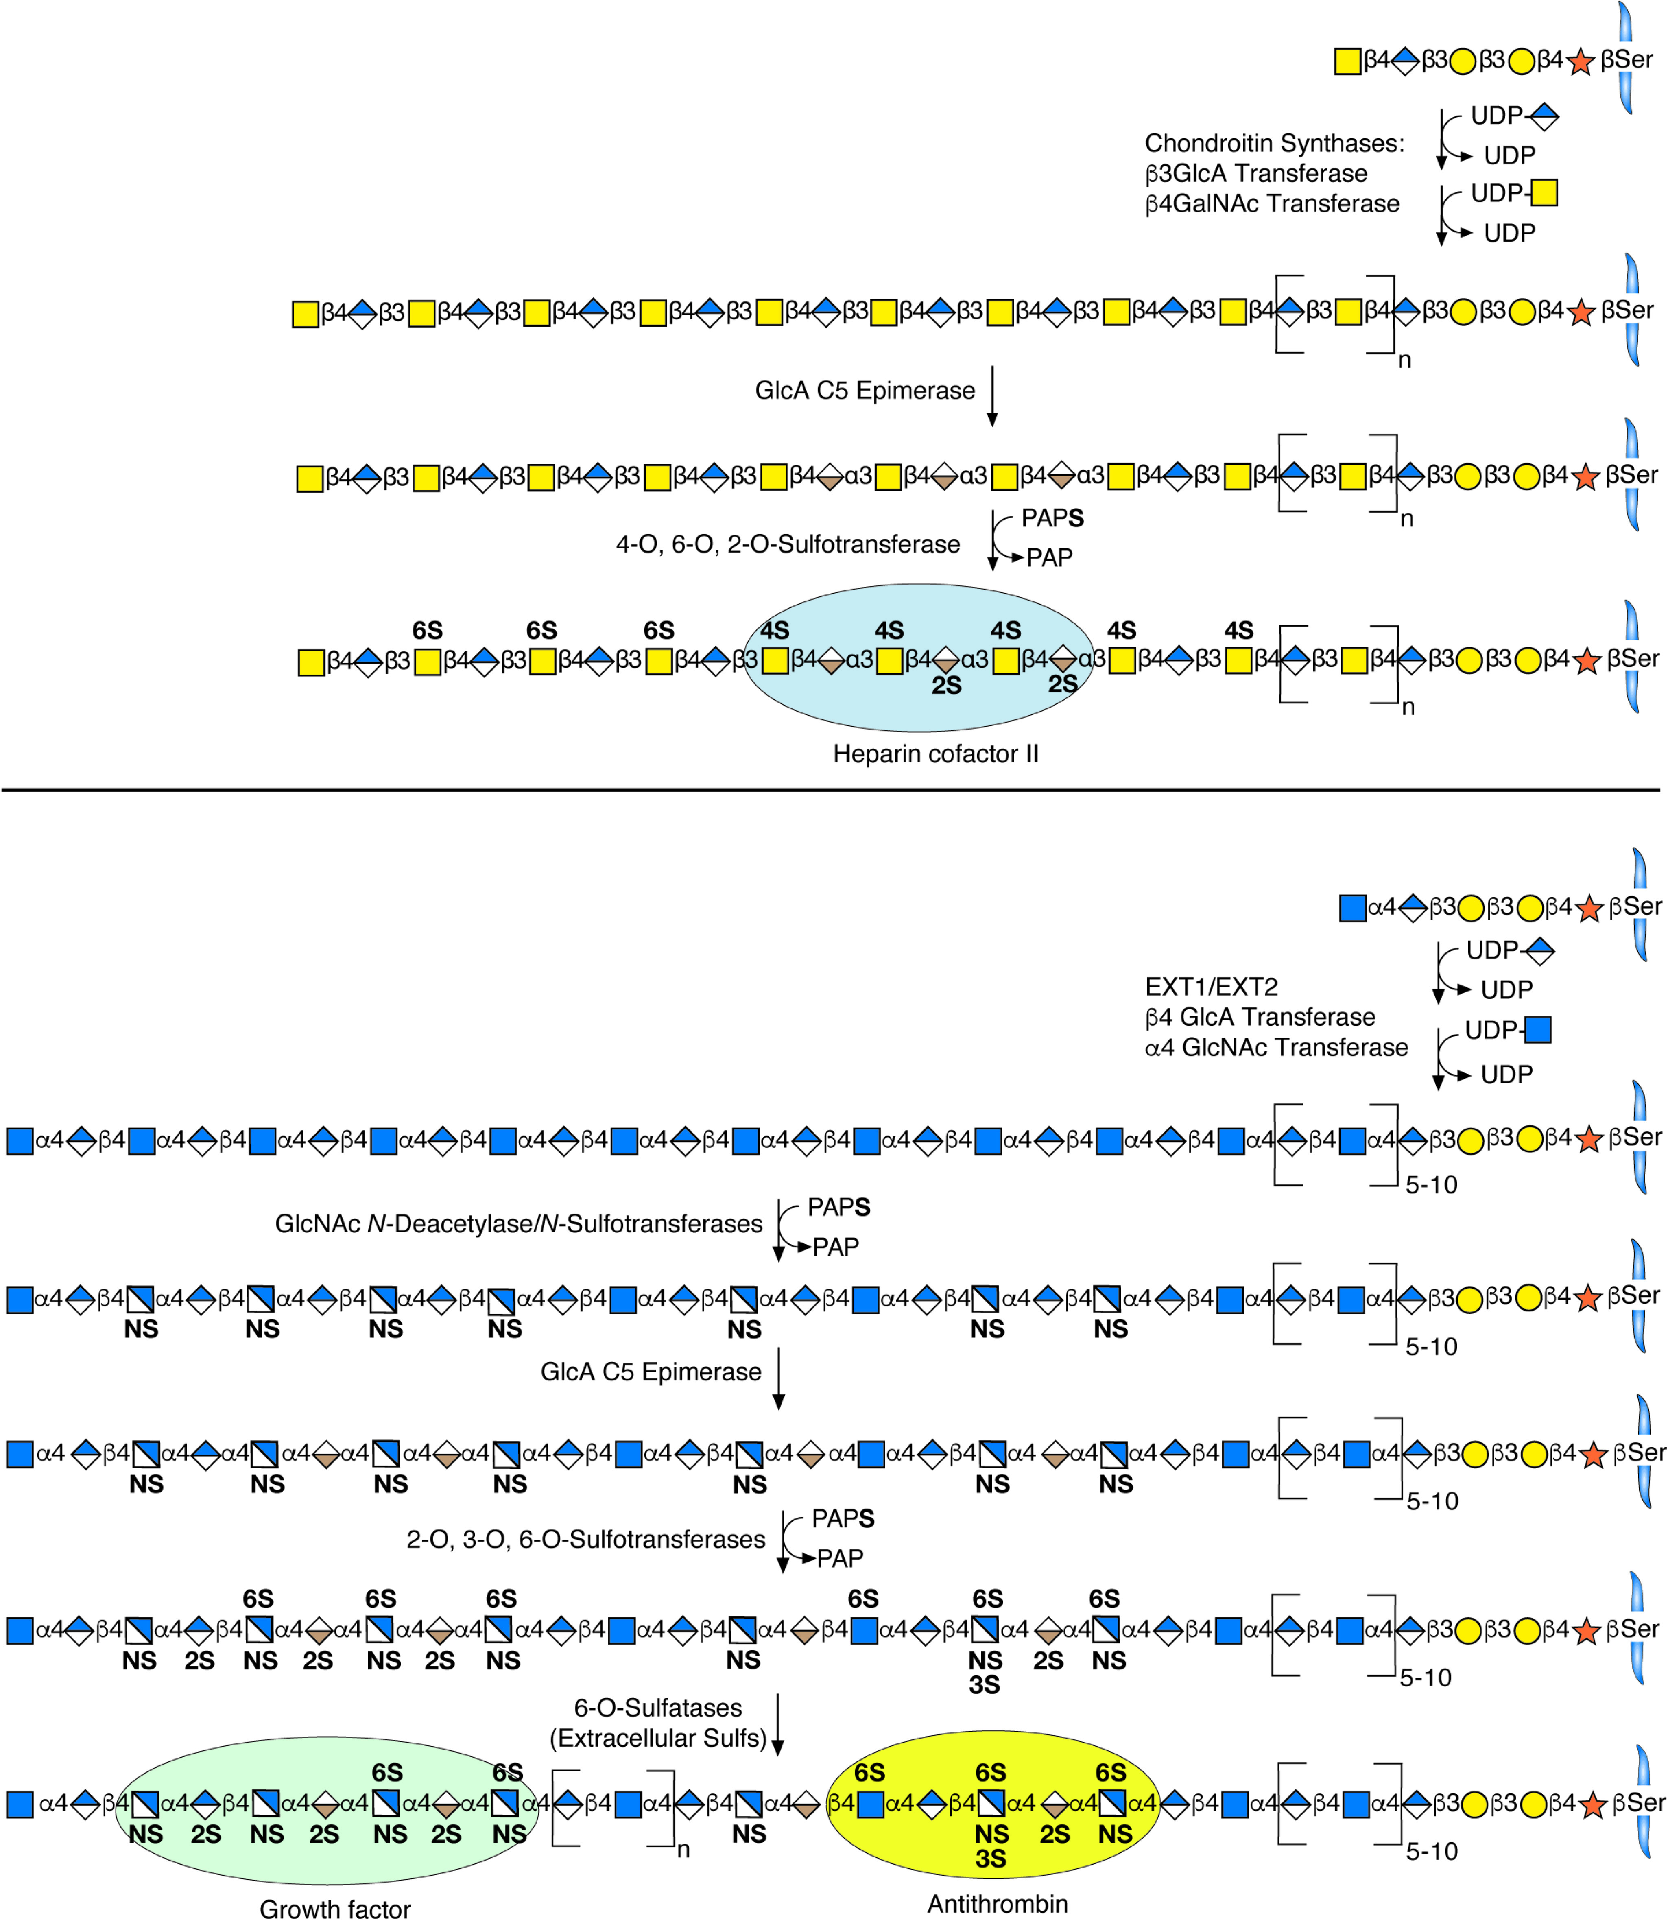
Biosynthesis of Chondroitin Sulfate/Dermatan Sulfate
Chapter 17, Figure 5. Essentials of Glycobiology, Fourth Edition
Click here for Symbol Nomenclature for Glycans (SNFG) (Live only in slide display mode)
Buy the Book
©2022 The Consortium of Glycobiology Editors, La Jolla, California
Notes:
(Note: Embedded links are present but live only in the slide display mode.)
FIGURE 17.5. Biosynthesis of chondroitin sulfate/dermatan sulfate involves the polymerization of N-acetylgalactosamine and glucuronic acid units and a series of modification reactions including O-sulfation and epimerization of glucuronic acid to iduronic acid. Heparan sulfate biosynthesis involves copolymerization of N-acetylglucosamine and glucuronic acid residues. Additional modification by uronic acid epimerization and N- and O-sulfation occur in an incomplete and interdependent manner throughout the chain, with clustered sulfation forming sulfated domains separated by regions of low or no sulfation.

Slide 32
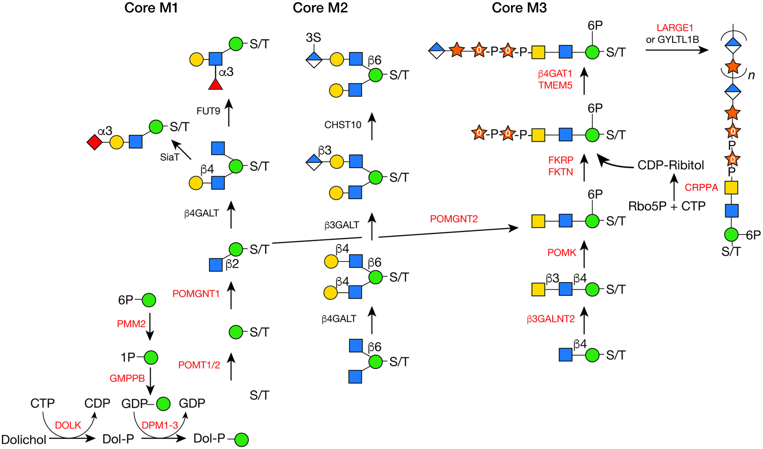
O-Man Glycan Biosynthetic Pathway
Chapter 45, Figure 3. Essentials of Glycobiology, Fourth Edition
Click here for Symbol Nomenclature for Glycans (SNFG) (Live only in slide display mode)
Buy the Book
©2022 The Consortium of Glycobiology Editors, La Jolla, California
Notes:
(Note: Embedded links are present but live only in the slide display mode.)
FIGURE 45.3. O-Man glycan biosynthetic pathway. The biosynthetic pathways of representative O-Man glycans are shown. Enzymes whose defects cause a disorder are indicated in red. Three main groups are identified: cores M1−M3. All O-Man glycans are initiated on either a serine (S) or a threonine (T) in the acceptor protein using two enzymes protein-O-mannosyltransferase 1 and 2 (POMT1/2) and Dol-P-Man donor. Several genes in the biosynthesis of Dol-P-Man (GMPPB, DPM1−3) are deficient in some patients with dystroglycanopathy, whereas others (DOLK, DPM1, and PMM2) cause a more generalized congenital disorder of glycosylation (CDG). Mannose receives either GlcNAcβ;1-2- to form core M1 or β1-4GlcNAc to form core M3. Mutations in both genes (POMGNT1 and POMGNT2) can cause a dystroglycanopathy. Core M2 can be formed if a branching β1-6GlcNAc is added. Core M1 and M2 are elongated by Gal and may terminate with Fuc, Sia, and GlcA with optional sulfation. None of the genes responsible for adding the terminal sugars have been associated with dystroglycanopathies. After the addition of the β1-4GlcNAc, core M3 is elongated with GalNAc, and then the Man is 6-O-phosphorylated via a specific kinase (POMK, also known as SGK196). With help of POMGNT1, FKTN and FKRP can act to add two ribitol-5-phosphate units to the GalNAc residue that is then extended with a single Xyl and GlcA by TMEM5 and B4GAT1, respectively. Ribitol-5-phosphate used by FKTN and FKRP is synthesized from CDP-ribitol by CRPAA, also known as ISPD. Mutations in these genes (B3GALNT2, POMK, FKTN, FKRP, CRPPA, TMEM5, and B4Gat1) can cause a dystroglycanopathy. The last defined step in core M3 biosynthesis is using this Xyl-GlcA primer for the stepwise addition of Xyl and GlcA to form a GAG-like repeating disaccharide termed matriglycan. This is catalyzed by the enzyme encoded by LARGE1 (or its homolog GYLTL1B) with dual glycosyltransferase activities. Matriglycan binds laminin to α-DG and its reduction or loss is believed to be the cause of most of the dystroglycanopathies (POMGNT1 mutations being the exception).

Slide 33
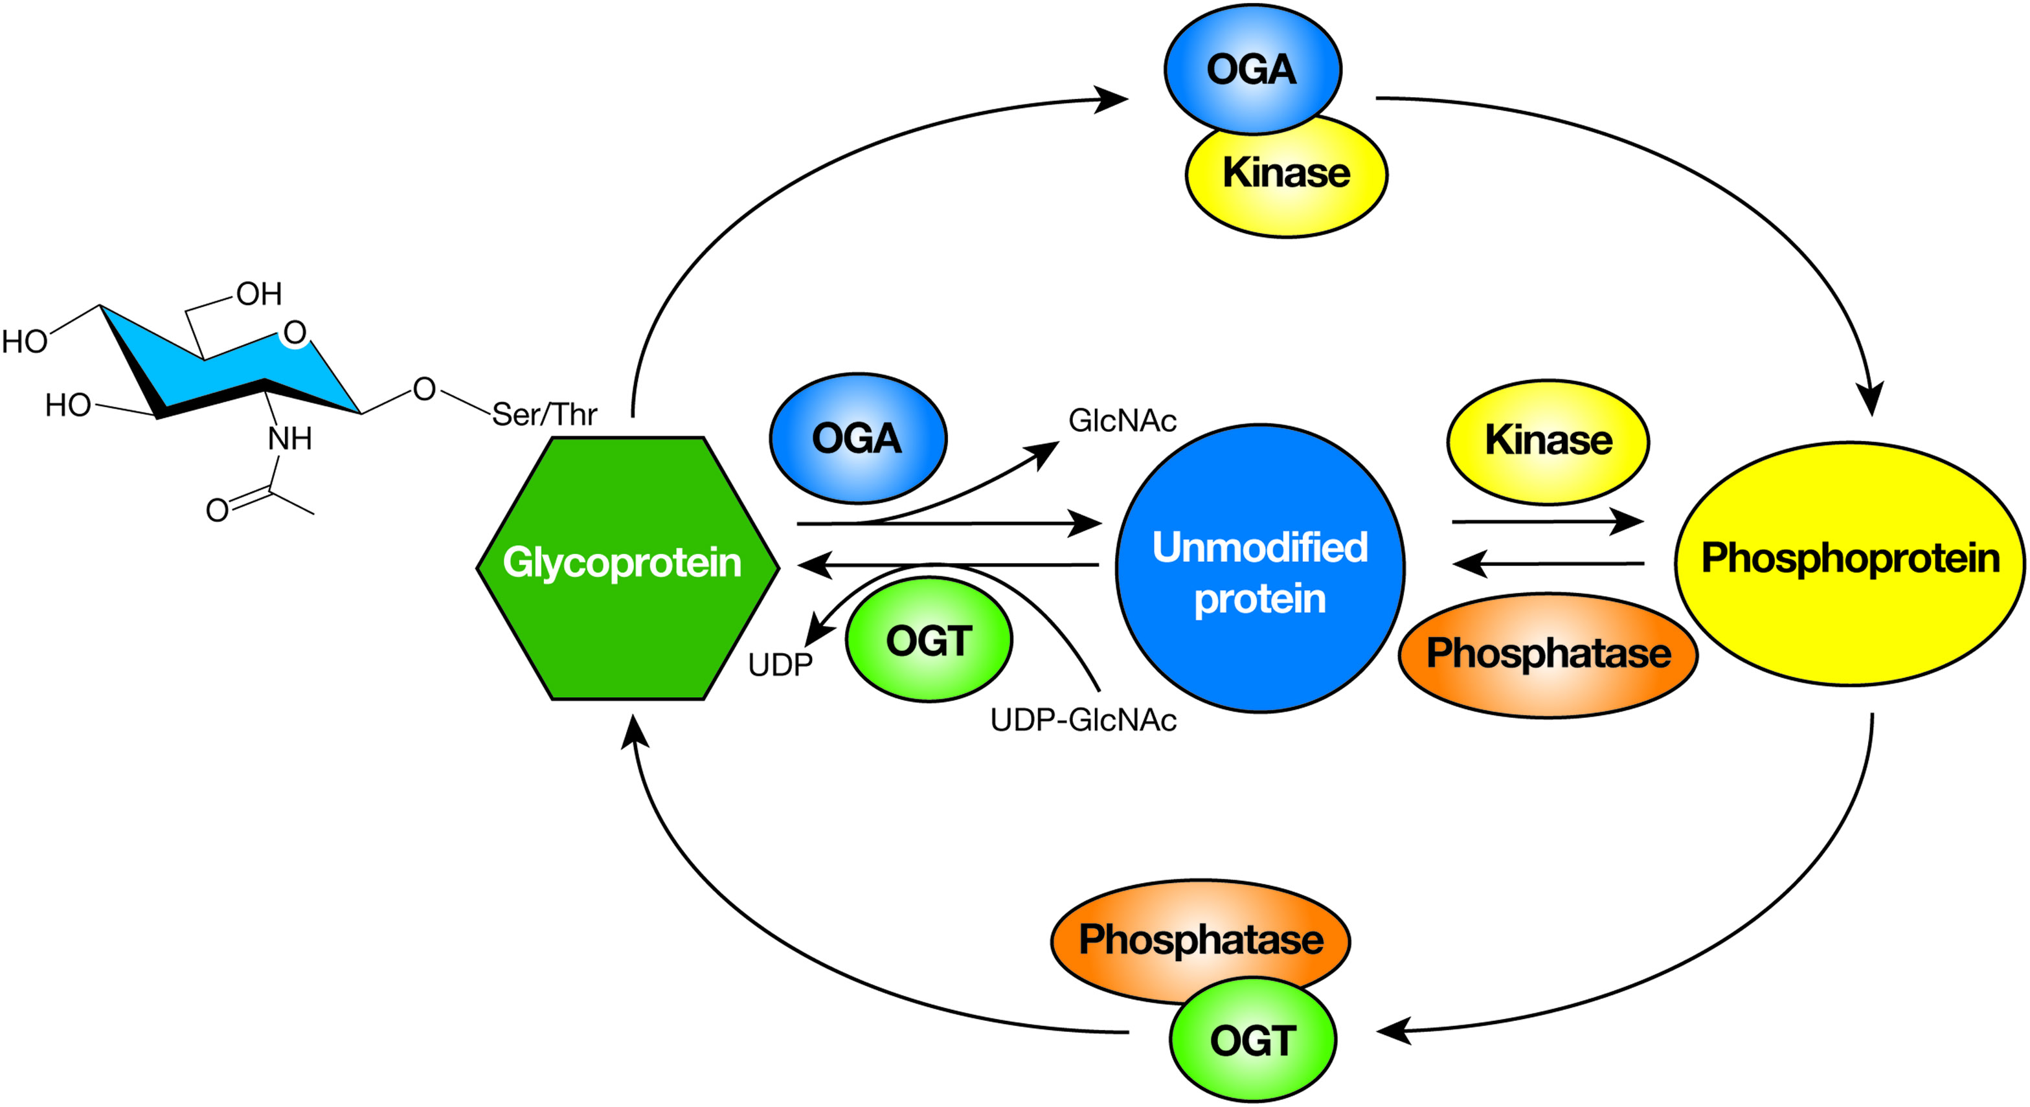
Many Nuclear, Mitochondrial, and Cytoplasmic Proteins are Modified by Monosaccharides of O-Linked β-N-Acetylglucosamine (O-GlcNAc)
Chapter 19, Figure 1. Essentials of Glycobiology, Fourth Edition
Buy the Book
©2022 The Consortium of Glycobiology Editors, La Jolla, California
Notes:
(Note: Embedded links are present but live only in the slide display mode.)
FIGURE 19.1. Many nuclear, mitochondrial, and cytoplasmic proteins are modified by monosaccharides of O-linked β-N-acetylglucosamine (O-GlcNAc). In mammals, O-GlcNAc is dynamically added and removed from proteins by just two enzymes, the O-GlcNAc transferase (OGT) and the O-GlcNAcase (OGA). On a subset of proteins, O-GlcNAc competes with phosphorylation for Ser/Thr residues. Evidence suggests that some proteins are rapidly cycled between phosphorylated and glycosylated states by protein complexes composed of OGT and protein phosphatase 1 β, γ, or OGA and protein kinases.

Slide 34
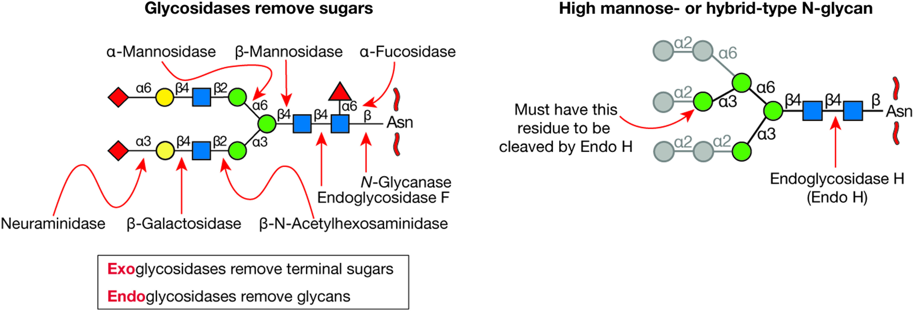
Glycosidases Used for Structural Analysis
Chapter 50, Figure 1. Essentials of Glycobiology, Fourth Edition
Click here for Symbol Nomenclature for Glycans (SNFG) (Live only in slide display mode)
Buy the Book
©2022 The Consortium of Glycobiology Editors, La Jolla, California
Notes:
(Note: Embedded links are present but live only in the slide display mode.)
FIGURE 50.1. Glycosidases used for structural analysis. (Left) A biantennary N-glycan is shown with exoglycosidases that remove each monosaccharide sequentially. Exoglycosidases act only on terminal sugars. Also shown are endoglycosidases that digest in the core region of the N-glycan. N-Glycanase cleaves the GlcNAc-Asn bond, releasing the N-glycan and converting Asn into Asp, which is diagnostic of an N-glycan site. Endo F cleaves between the core GlcNAc residues and therefore leaves a GlcNAc, with or without an attached fucose, linked to the protein. (Right) Endo H cleaves between the core GlcNAc residues of oligomannose or hybrid N-glycans that have at least four Man residues as shown. Endo H does not act on complex N-glycans.

Slide 35
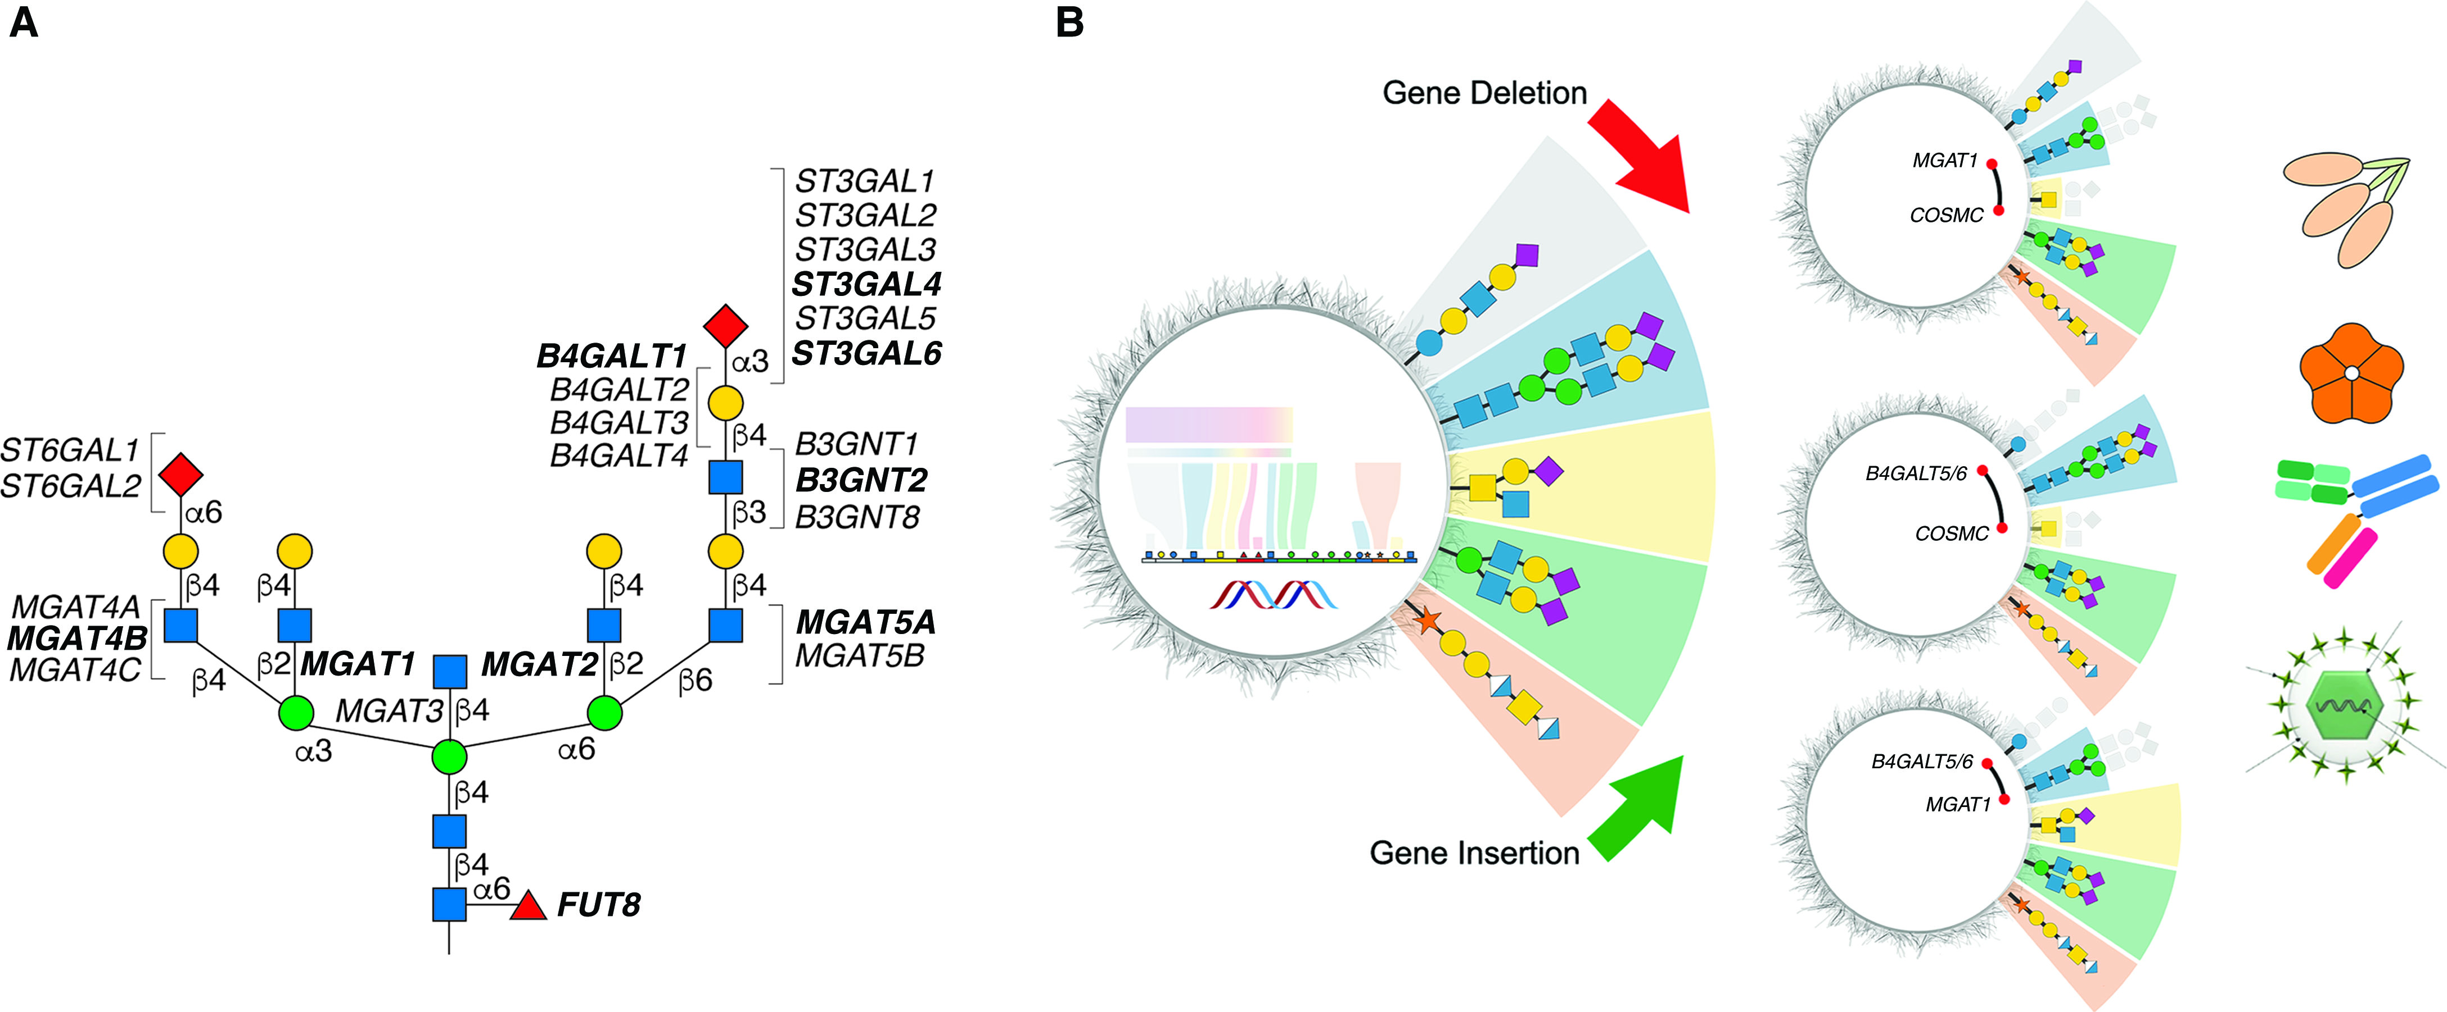
Genetic Alteration of Glycosylation
Chapter 56, Figure 3. Essentials of Glycobiology, Fourth Edition
Click here for Symbol Nomenclature for Glycans (SNFG) (Live only in slide display mode)
Buy the Book
©2022 The Consortium of Glycobiology Editors, La Jolla, California
Notes:
(Note: Embedded links are present but live only in the slide display mode.)
FIGURE 56.3. (A) A complex N-glycan with glycosyltransferases responsible for each reaction. Combinatorial knockout of the glycosyltransferase isoenzyme genes indicated led to the identification of the primary genes (highlighted in bold) controlling N-glycan branching (Mgats), elongation (B3gnts and B4galts), and sialylation (St3gals) in Chinese hamster ovary (CHO) cells. The methods discussed are equally applicable to the glycosyltransferases responsible for other types of glycosylation. (B) A generalized scheme for genetically altering the expression of different classes of glycans on cells. Gene deletions, insertions, or activation of glycosyltransferases can be used to generate isogenic cell lines that display different glycan features on endogenous surface glycoconjugates. Libraries of such engineered isogenic cells can be used to determine binding specificities of lectins, toxins, antibodies, or viruses. For illustration, isogenic cells with selective loss of different types of glycans are shown (loss of elaborated N-glycans [KO MGAT1], O-glycans [KO C1GALT1], and glycosphingolipids [KO B4GALT5/6]).

